Slide 1
KSRM COLLEGE OF ENGINEERING (AUTONOMOUS)
Department of Computer Science and Engineering
A
Project Review
On
Heart Disease Prediction
Using Machine Learning
Project Members : Project Guide :
C. ASHISH (189Y1A0524) Sri. Md. Rahmathulla, M.Tech.
B. JAGADEESH(189Y1A0518) Assistant Professor,
G. NITHIN (189Y1A0545) Dept. of C.S.E.
D. MURTHY (189Y1A0531)

Slide 2
Heart Disease Prediction
USING MACHINE LEARNING

Slide 3
CONTENTS
ABSTRACT - INTRODUCTION
EXISTING SYSTEM AND IT’S DISADVANTAGES
PROPOSED SYSTEM AND IT’S ADVANTAGES
MODULES
DATASET
IMPLEMENTING ML ALGORITHMS
COMPARING ACCURACIES
SYSTEM ARCHITECTURE
SOFTWARE AND HARDWARE REQUIREMENTS
CONCLUSION
REFERENCES

Slide 4
ABSTRACT
Heart attack disease is one of the leading causes of the death worldwide. In the modern era, approximately one person dies per minute due to heart disease.
Predicting the occurrence of disease at early stages is a major challenge nowadays.
This is where Machine learning can be used. Early detection of cardiac diseases and continuous supervision of clinicians can reduce the mortality rate.
Machine learning algorithms have shown promising results in accurately diagnosing and risk stratifying patients with concern for coronary artery disease.

Slide 5
INTRODUCTION
Based on W.H.O. reports, every year 12 million deaths occur worldwide due to Heart Disease. Thus, there is an implicit necessity to predict the condition at the earliest.
Machine learning (ML) is a type of artificial intelligence (AI) that allows software applications to become more accurate at predicting outcomes without being explicitly programmed to do so. Machine learning algorithms use historical data as input to predict new output values.
This project aims to predict future Heart Disease by analyzing data of patients which classifies whether they have heart disease or not using machine-learning algorithms.

Slide 6
Existing System
There are many existing algorithms like KNN, NB, SVM to predict heart disease using machine learning. Though all these algorithms can be used for prediction, sometimes they can predict inaccurate and can take more time. Due to this there will be many problems for predicting incorrectly.
Disadvantages of Existing system :
Low Accuracy rates.
It requires much computational power.
Higher time required to train datasets.
Accuracy depends on the quality of the data.

Slide 7
Proposed System
To overcome this we are implementing Decision Tree Classifier in order to achieve accurate results in less time.
Advantages of Proposed system :
Compared to other algorithms Decision trees requires less effort for data preparation during pre-processing.
There will be no impact of missing values.
A decision tree does not require normalization and scaling of data.
It has High performance and accuracy rates in Classification.

Slide 8
Modules
Data Collection - Heart Disease dataset taken from Kaggle (https://www.kaggle.com/code/ronitf/predicting-heart-disease/notebook)
Data Preprocessing - remove duplicates, correct errors, deal with missing values, normalization, data type conversions and prepare a final dataset.
Login - Firstly , we login to the website by using default login id & password.
Training Model - Then, we have to train the model by uploading the dataset file.
Inputs - You’ll be redirected to another page where you have to provide inputs such as age, sex, type of chest pain, resting blood pressure, cholesterol levels, Resting ECG, max. heart rate and more.
Prediction - By reading the given inputs the model predicts the outcome of the patient.

Slide 9
Dataset
These are some of the attributes used to train the model. The dataset consisting of the parameters including age, sex, chest pain type, serum cholesterol, resting blood pressure, resting ECG etc.,
 | age | sex | cp | restbps | chol | fbs | restecg | thalach | exang | oldpeak | slope | target
0 | 52 | 1 | 0 | 125 | 212 | 0 | 1 | 168 | 0 | 1.0 | 2 | 0
1 | 53 | 1 | 0 | 140 | 203 | 1 | 0 | 155 | 1 | 3.1 | 0 | 0
2 | 70 | 1 | 0 | 145 | 174 | 0 | 1 | 125 | 1 | 2.6 | 0 | 0
3 | 50 | 0 | 0 | 110 | 254 | 0 | 0 | 159 | 0 | 0.0 | 2 | 1
4 | 62 | 0 | 0 | 138 | 294 | 1 | 1 | 106 | 0 | 1.9 | 1 | 0

Slide 10
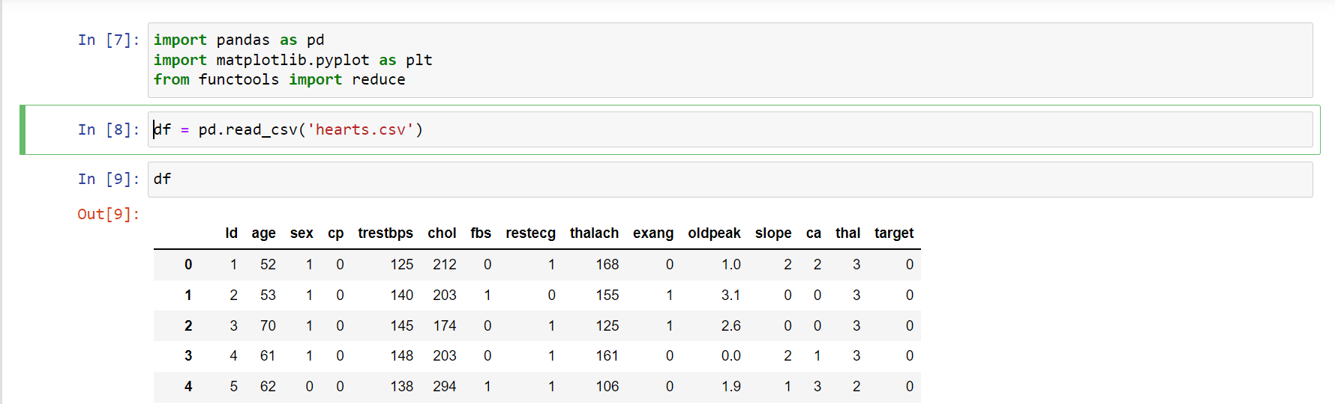
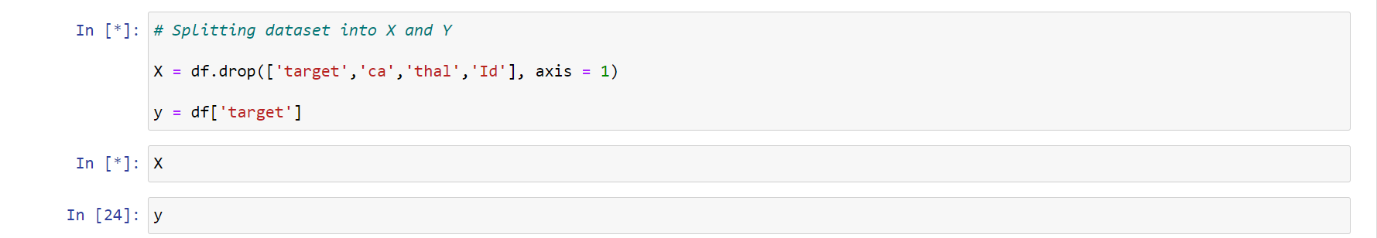
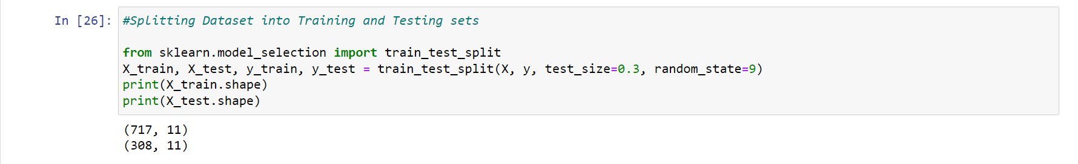

Slide 11
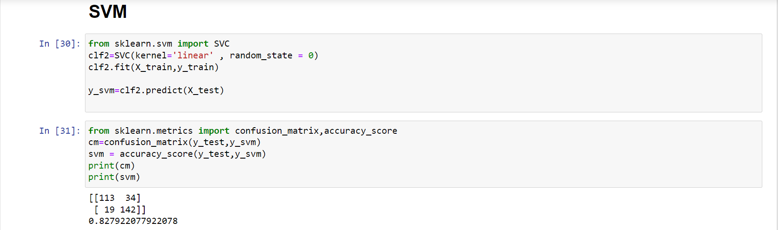
Implementing Support Vector Machine
SVM : Given a set of training examples, each marked as belonging to one of two categories, an SVM training algorithm builds a model that predicts whether a new example falls into one category or the other.
Linear SVM : Linear SVM is used for data that are linearly separable i.e. for a dataset that can be categorized into two categories by utilizing a single straight line. Such data points are termed as linearly separable data, and the classifier is used described as a Linear SVM classifier.
We get an accuracy of 82.7 % using SVM

Slide 12
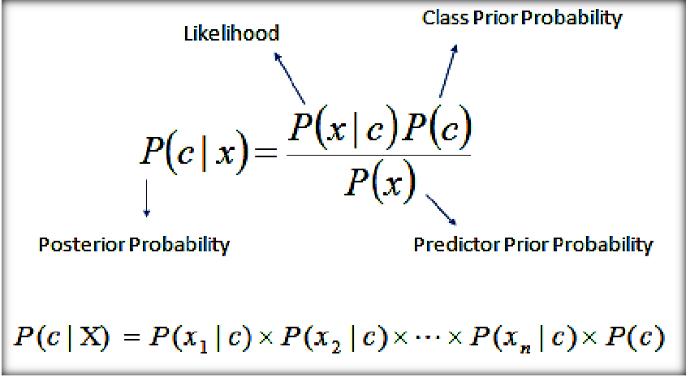
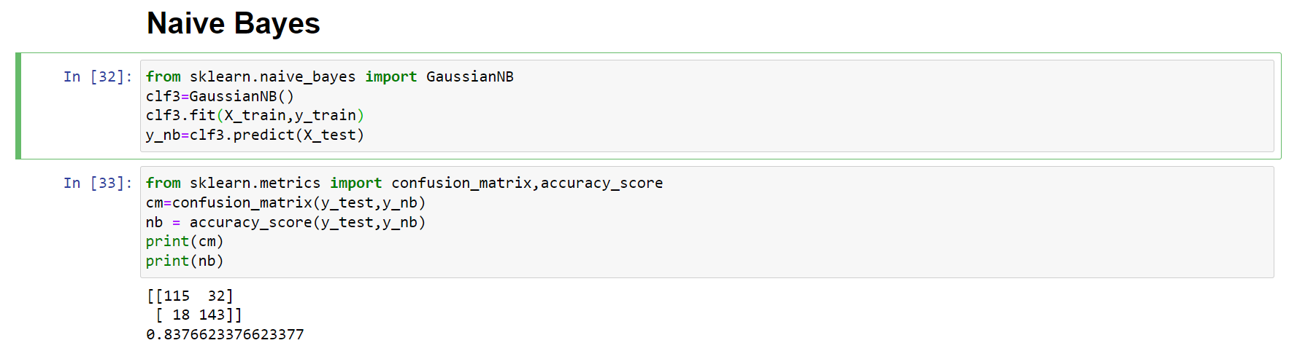
Implementing Naïve Bayes Classifier
Naïve Bayes Classification : Naive Bayes is a simple technique for constructing classifiers: models that assign class labels to problem instances, represented as vectors of feature values, where the class labels are drawn from some finite set.
The accuracy observed using Naïve Bayes is 83.7 %

Slide 13
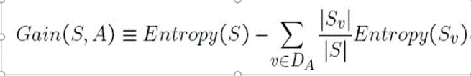
Implementing Decision Tree Classifier
A Decision tree is a flowchart like tree structure, where each internal node denotes a test on an attribute, each branch represents an outcome of the test, and each leaf node (terminal node) holds a class label.
ID3 is algorithm which is used to build decision trees. ID3 has some features like removing outliers, handling missing values.
An instance is classified by starting at the root node of the tree, testing the attribute specified by this node, then moving down the tree branch corresponding to the value of the attribute.
Decision Tree selects the root node from the list of attributes by the criteria for which the Information gain is maximum.
Information Gain : The information gain function is known as measure of the “reduction in entropy”.
It measures how well a given attribute separates the training examples according to their target classification.

Slide 14
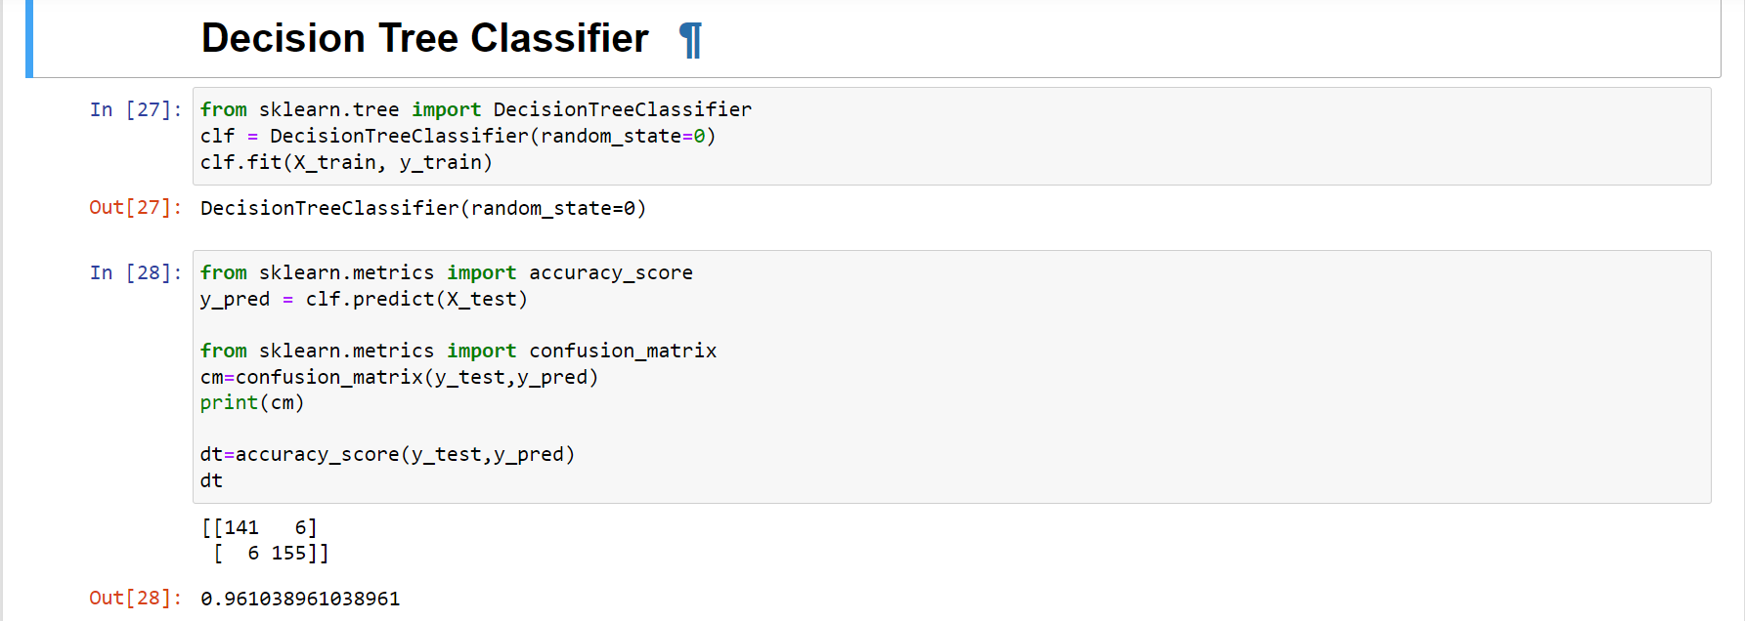
>> An accuracy of 96% is observed for Decision Tree Classifier.

Slide 15
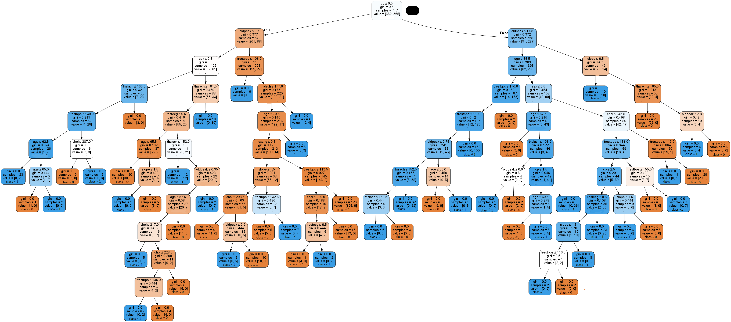
Decision Tree

Slide 16
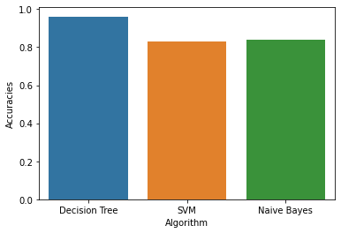
Comparing Accuracies of different Algorithms
0.961039 || 0.827922 || 0.837662

Slide 17

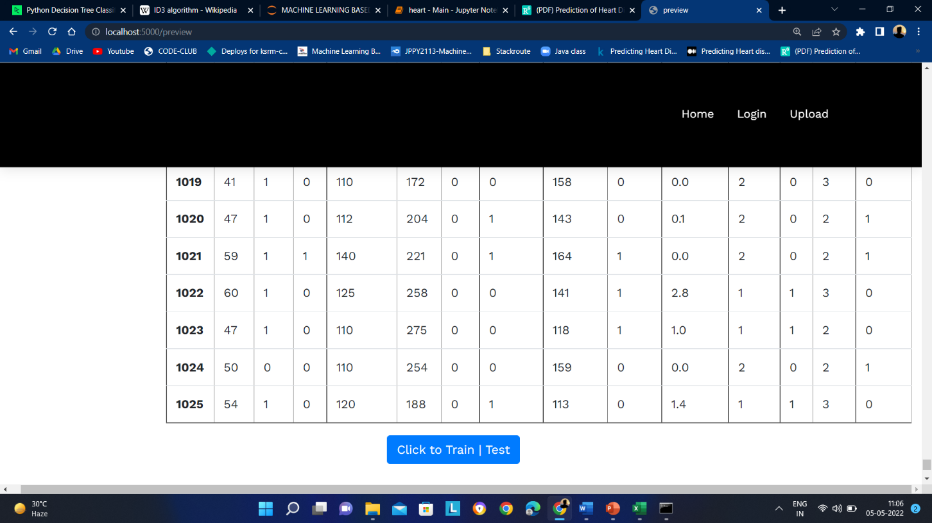

Output Screens

Slide 18
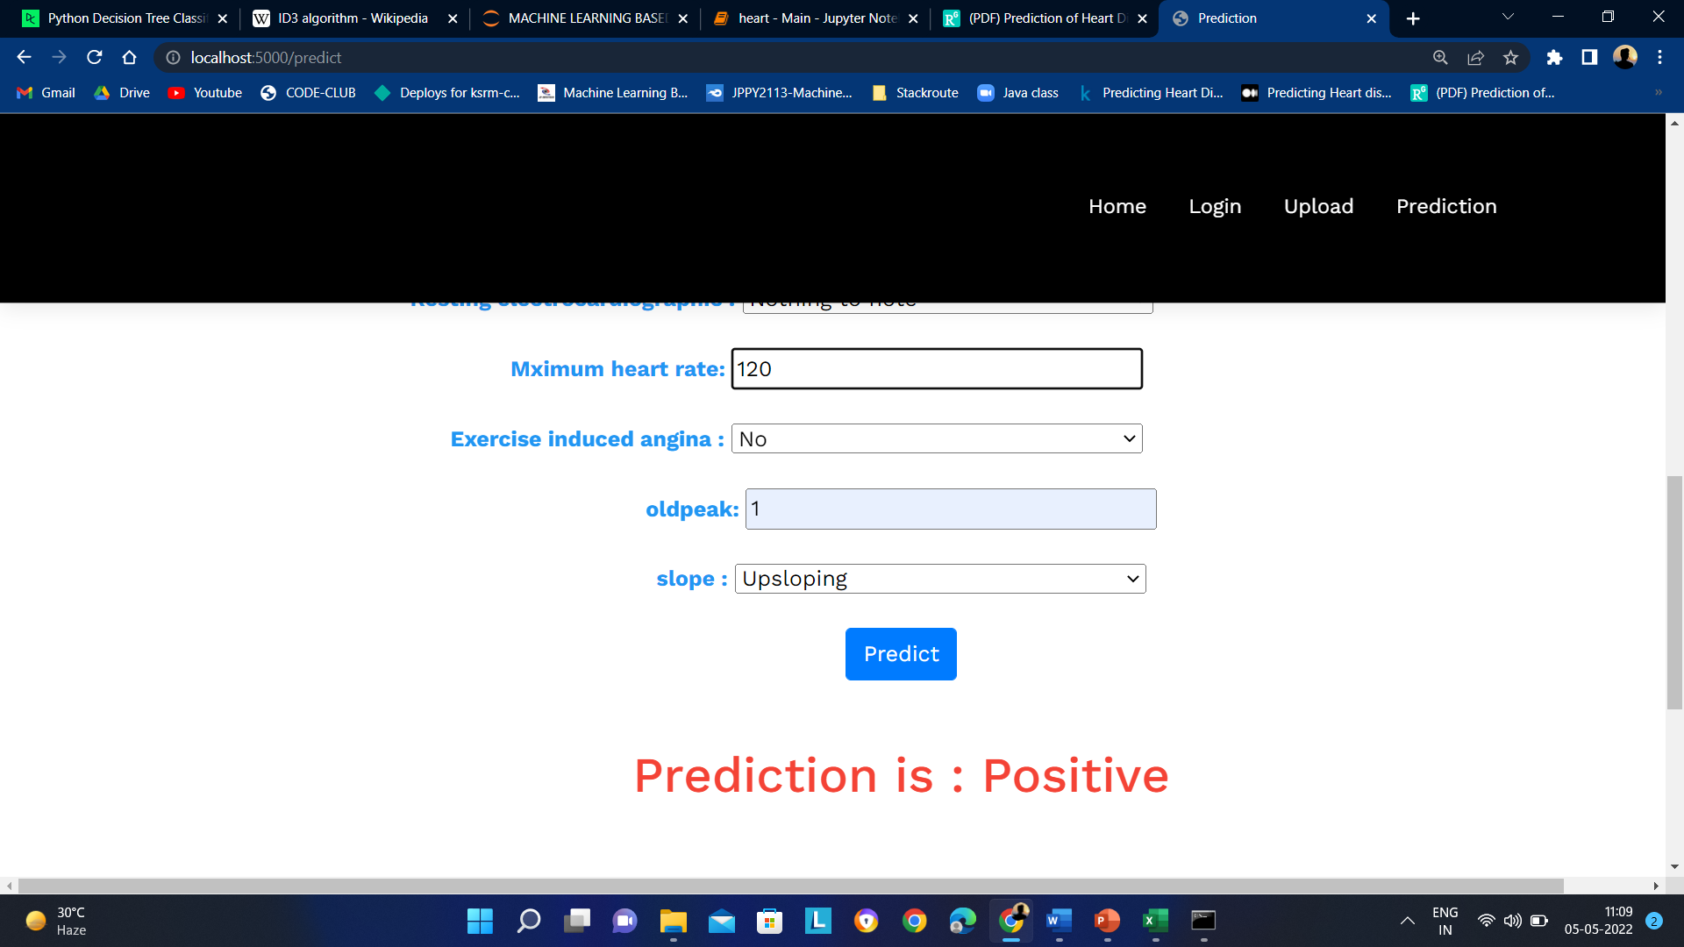

Slide 19
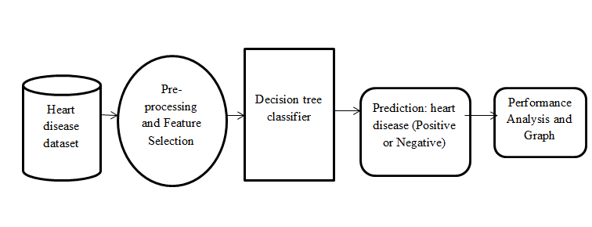
SYSTEM ARCHITECTURE

Slide 20
Software and Hardware Requirements
Software Requirements :
Operating system : Windows 10.
Coding Language : Python
Web Framework : Flask
Hardware Requirements :
System : min. Pentium i3 Processor.
Hard Disk : 500 GB.
Monitor : 14’’ LED
Input Devices : Keyboard, Mouse
Ram : 4 GB

Slide 21
CONCLUSION
Decision Tree is an efficient algorithm for classification problems. Predicting Heart disease is a classification problem with classes Positive and Negative. In this, what we found is during small datasets in some other cases most of time other algorithms direct us to a solution which is not accurate, but when we look at Decision Tree results we are getting more accurate results.
This algorithm constructs decision tree based on the important attributes and classifies the new input. So accuracy of prediction at early stages is achieved effectively. We got an accuracy of 96% using Decision Tree Classification.
With this application if the patient/user is away from reach of doctor, he/she can make use of the application in prediction of disease just by entering the report values. And can proceed further whether to consult a doctor or not.

Slide 22
REFERENCES
M. Snehith Raja; M. Anurag; Ch. Prachetan Reddy; Nageswara Rao Sirisala, “Machine Learning Based Heart Disease Prediction System”, IEEE Conference, 2021
M.M. Kirmani and S.I. Ansarullah, "Prediction of heart disease using decision tree a data mining technique", IJCSN Int. J. Comput. Sci. Netw., vol. 5, no. 6, pp. 885-892, 2016.
M.A. Jabbar, B.L.Deekshatulu, and Priti Chandra, “Intelligent heart disease prediction system using random forest and evolutionary approach”, Journal of Network and Innovative Computing, Vol. 4, pp.174-184, 2016.
<<
Predicting Heart disease using Machine Learning | by Pulkit Khandelwal | Analytics Vidhya | Medium

